Slide 1
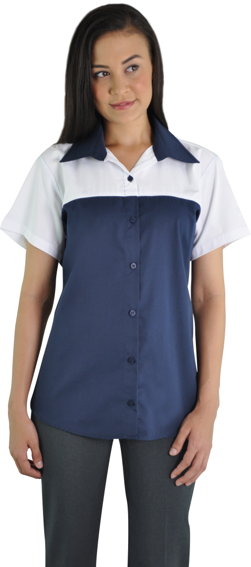
MECHANICAL & GARAGE UNIFORMS

